Slide 1
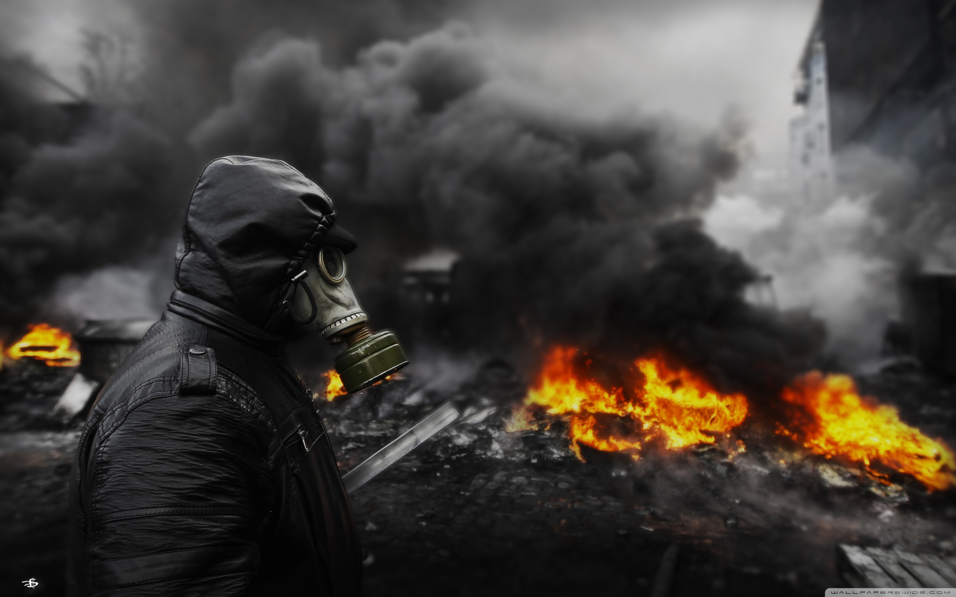
INDUSTRIAL DISASTERS
(WORLD)
- HIR KUBADIA

Slide 2
INDUSTRIAL DISASTER
An industrial disaster is an event which causes widespread destruction in industrial settings by chemical or radioactive releases from industrial point sources.
An industrial disaster is a serious event that involves hazardous materials and that can have consequences for the surrounding population and environment.

Slide 3
MAJOR INDUSTRIES
Defence Industry
Energy Industry
Mining Industry
Manufacturing Industry
Food Industry

Slide 4
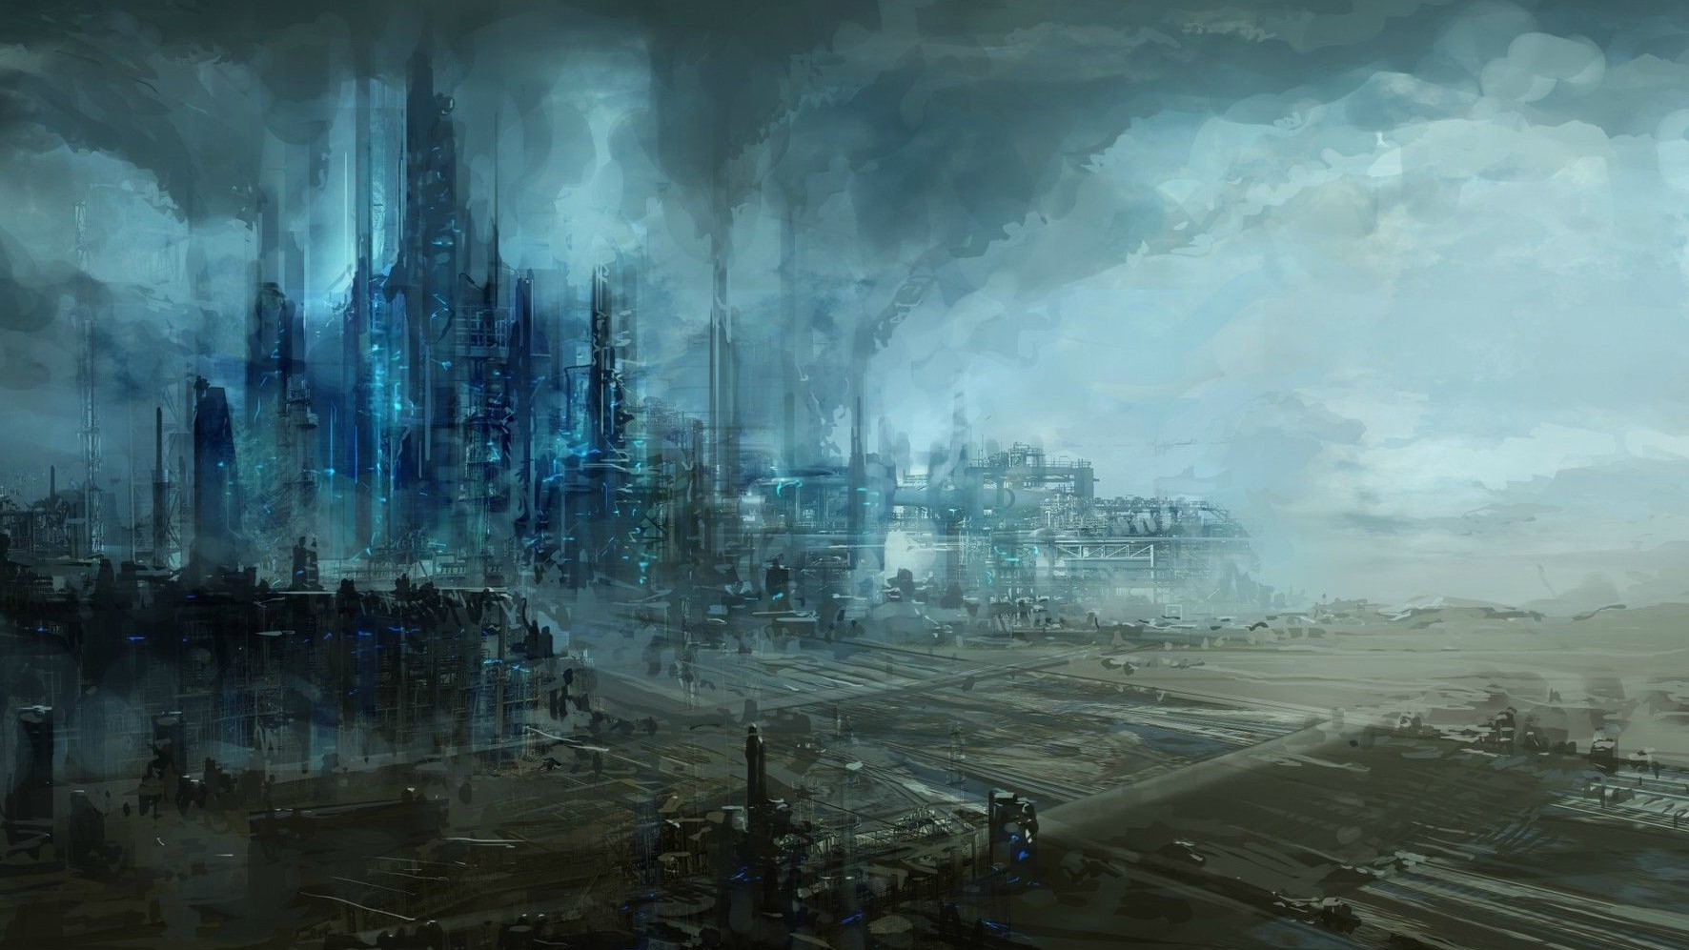
MAJOR INDUSTRIAL
DISASTERS

Slide 5
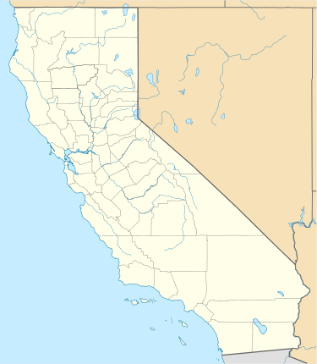
PORT CHICAGO DISASTER (24th July, 1944)
13th July, 1944:- Untrained NSGL trainees forced to load heavy ammunitions(weighing 4600 tons) onto SS E. A. Bryan.
On 14th July, 1944, the newly built Victory ship SS Quinault Victory was docked right next to SS Bryan.

Slide 6
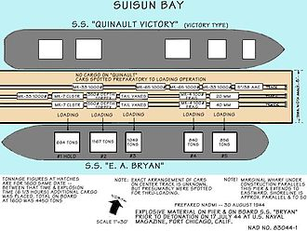
17th July, 1944, around 10:00 PM, a coast guard noticed that the Quinault Victory′s propeller was slowly turning over and reported hearing a noise described as "a metallic sound and rending timbers, such as made by a falling boom.“
In just few seconds an explosion occurred which detonated all the ammunitions loaded in SS Bryan. Chunks of hot glowing metal flung over 12,000 ft.

Slide 7
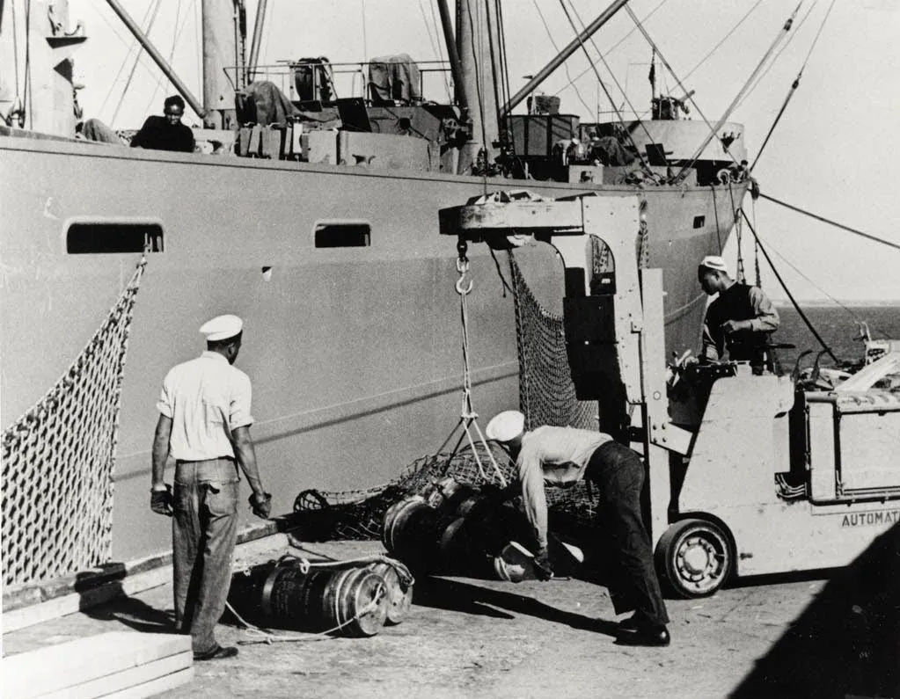
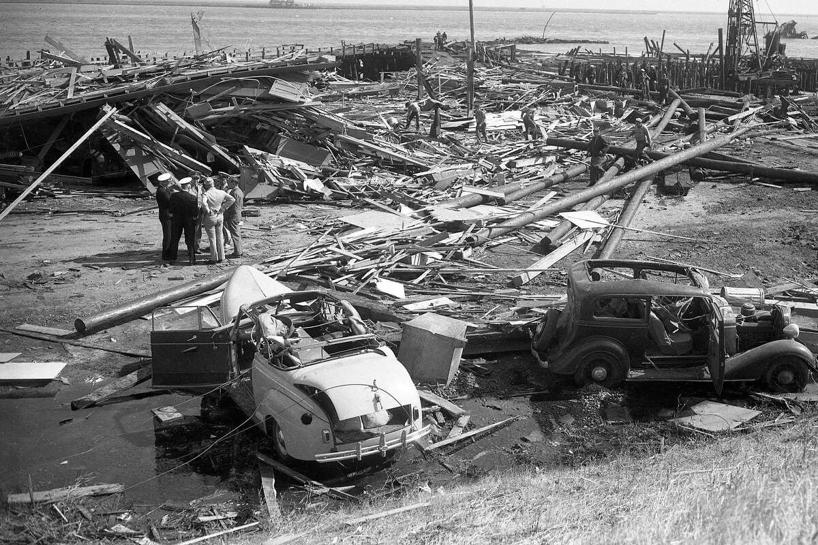
Loading of SS E. A. Bryan
Port Image after Explosion

Slide 8
LOSS
All 320 of the men on duty at the pier died instantly, and 390 civilians and military personnel were injured, many seriously.
Nearly $9.9 million worth of damage ($152.4 million in 2021) was caused to U.S. government property.
Seismographs at the University of California, Berkeley sensed the two shock waves traveling through the ground, determining the event to be equivalent to an earthquake measuring 3.4 on the Richter magnitude scale.

Slide 9
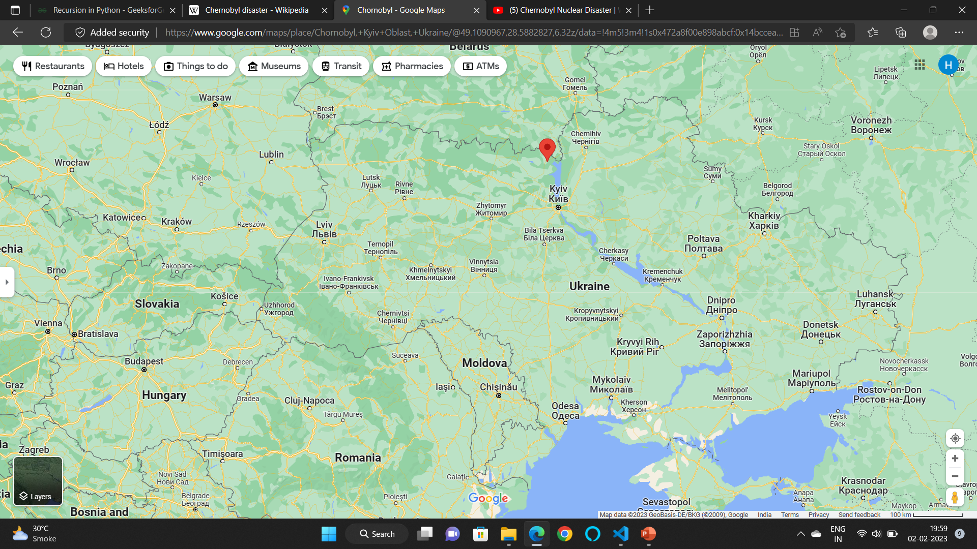
CHERNOBYL DISASTER (26TH APRIL, 1986)
The Chernobyl disaster was a nuclear accident that occurred on 26th April 1986 at the No. 4 reactor in the Chernobyl Nuclear Power Plant, near the city of Pripyat in the north of the Ukrainian SSR in the Soviet Union.
It is one of only two nuclear energy accidents rated at 7—the maximum severity—on the International Nuclear Event Scale.

Slide 10
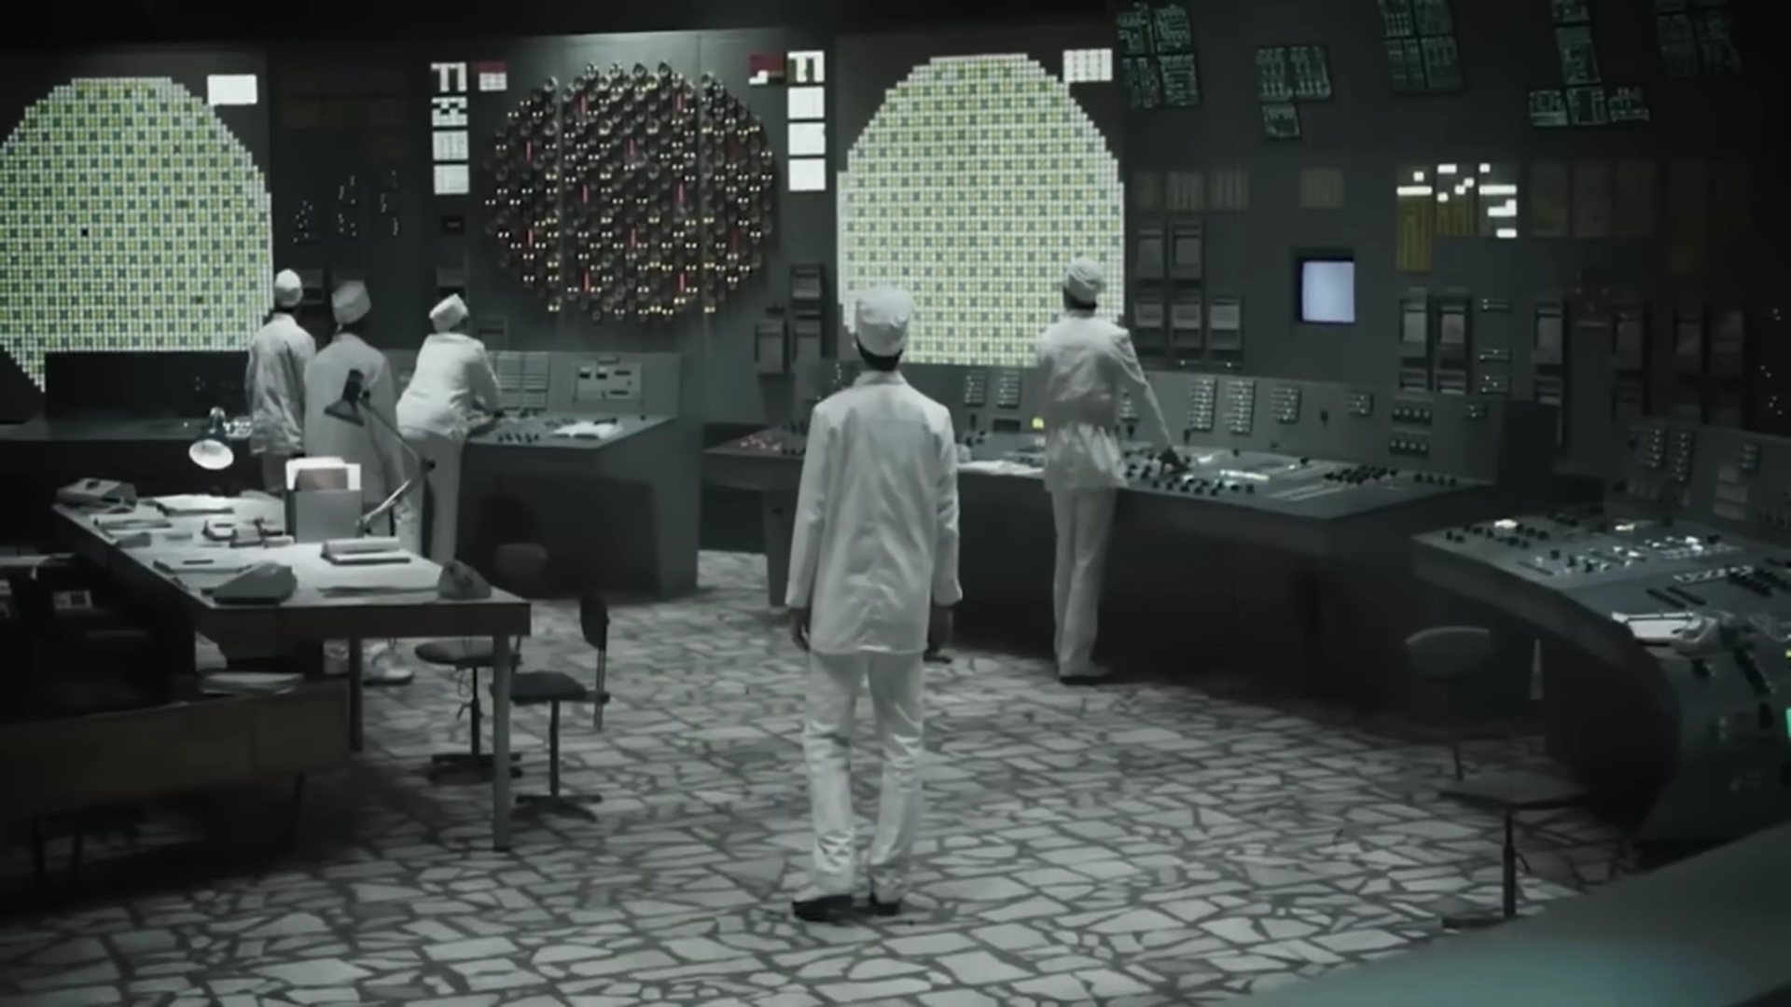
WHAT ACTUALLY HAPPENED?
The accident occurred during a safety test meant to measure the ability of the steam turbine to power the emergency feedwater pumps of an RBMK-type nuclear reactor in the event of a simultaneous loss of external power and major coolant leak.

Slide 11
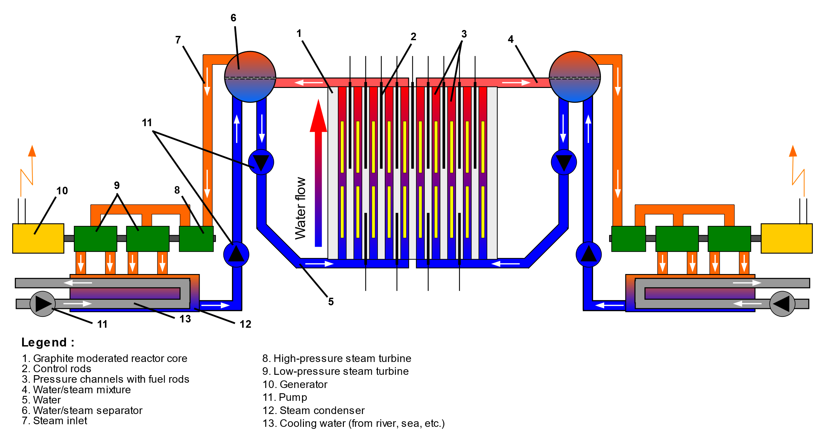
During the test, the operators dropped power output to near-zero, due partially to xenon poisoning. To stabilize it, the operators removed a number of control rods which exceeded limits set by the operating procedures.

Slide 12
The test was declared ‘failed’ and the operators triggered a reactor shutdown. Due to a design flaw, leading to a rapid decrease in pressure which caused the coolant to flash to steam. This decreased neutron absorption, leading to an increase in reactor activity, which further increased coolant temperatures.
This process resulted in steam explosions and melting of the reactor core, followed by huge blasts which blew the ceiling of the reactor to

Slide 13
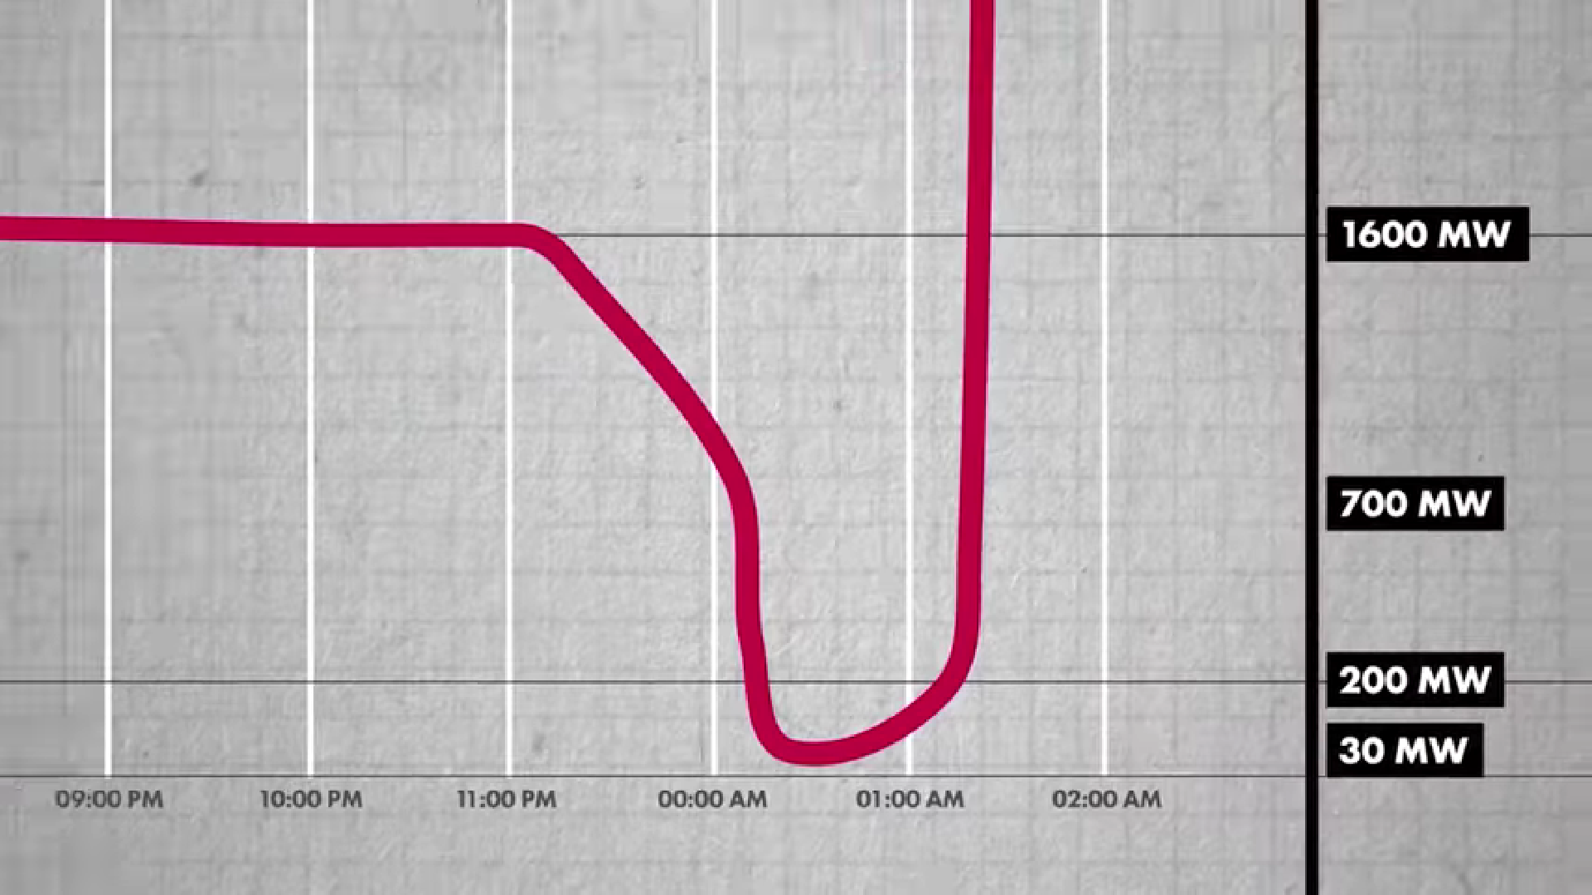
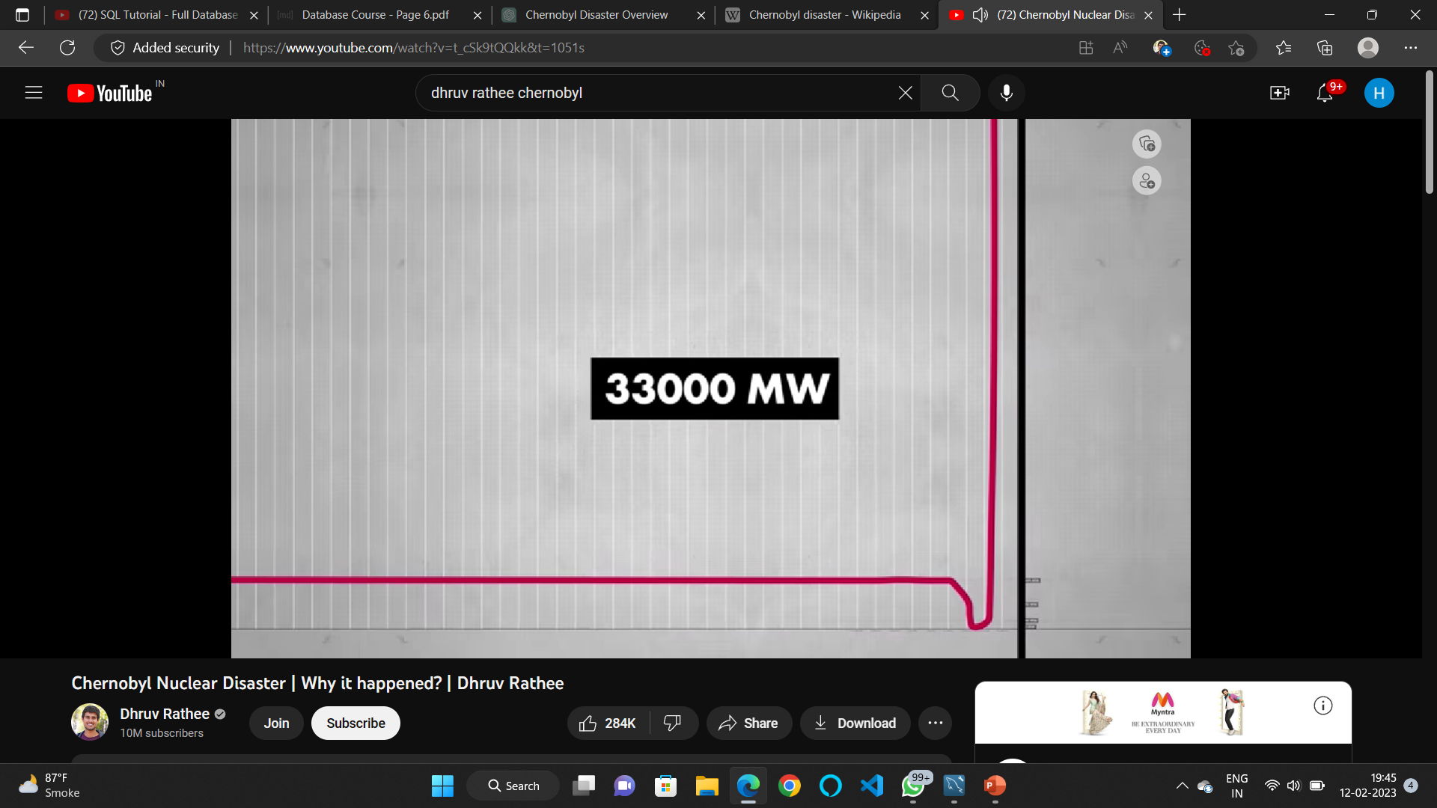
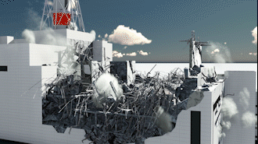
Trigger Pressed

Slide 14
DEATHS AND LOSS
Immediate Deaths:
Two plant workers were killed in the explosion and subsequent fire. In addition, 29 fire-fighters and plant workers died from acute radiation sickness in the months following the disaster.
Long-term Impact:
It is estimated that the disaster resulted in thousands of deaths, primarily due to an increased incidence of cancer and other diseases among those who were exposed to the radiation.

Slide 15
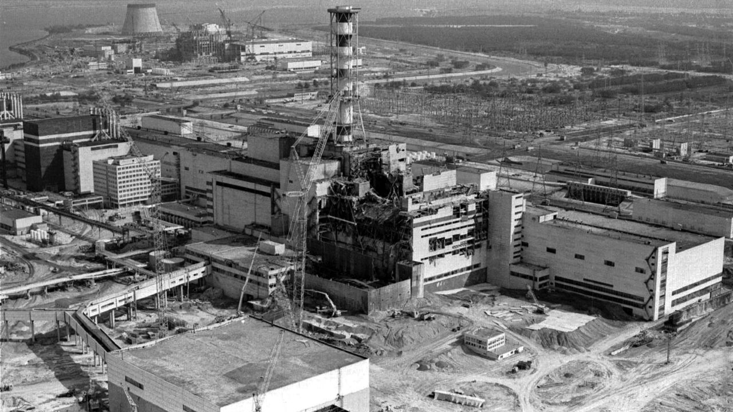
NOW WHAT?
When the site could be considered habitable again:
320 years or less (Ukraine state authorities, c. 2011)
3,000 years (Christian Science Monitor, 2016)
20,000 years or more (Chernobyl director Ihor Gramotkin, c. 2016)
Tens of thousands of years (Greenpeace, March 2016)

Slide 16
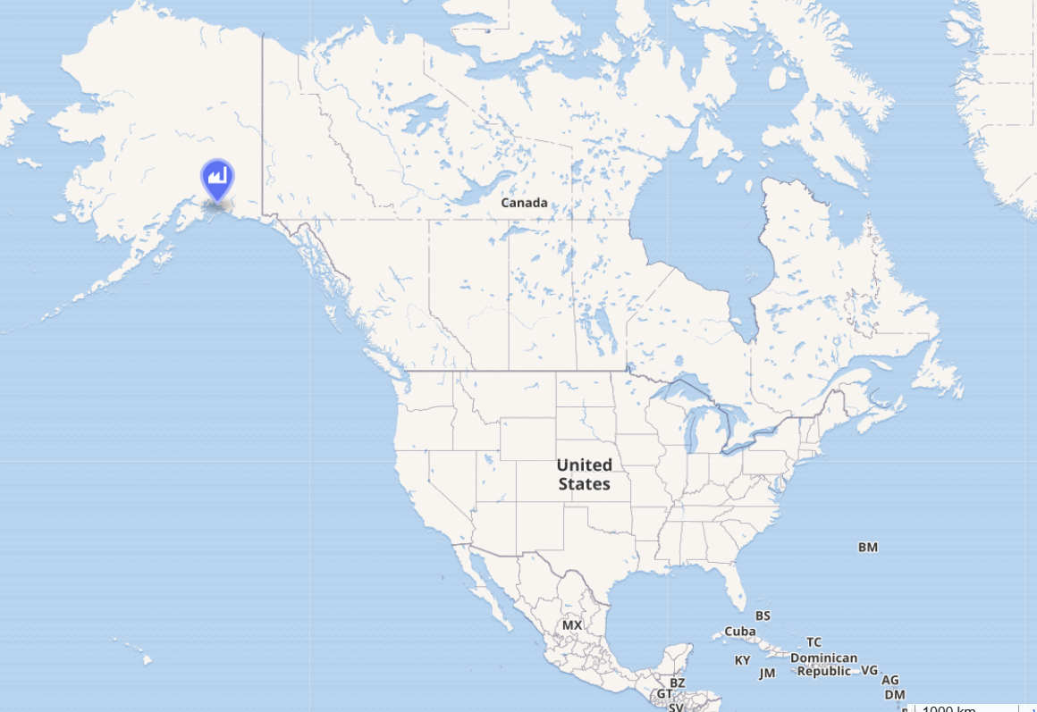
Exxon Valdez Oil Spill (March 24, 1989)
The Exxon Valdez oil spill occurred in the Prince William Sound, Alaska, on March 24, 1989. Exxon Valdez, an oil supertanker owned by Exxon Shipping Company bound for Long Beach, California struck Prince William Sound's Bligh Reef, 1.5 mi (2.4 km) west of Tatitlek, Alaska at 12:04 a.m. and spilled 10.8 million US gallons (37,000 tons) of crude oil over the next few days.

Slide 17
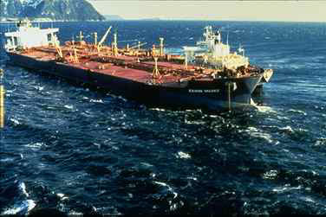
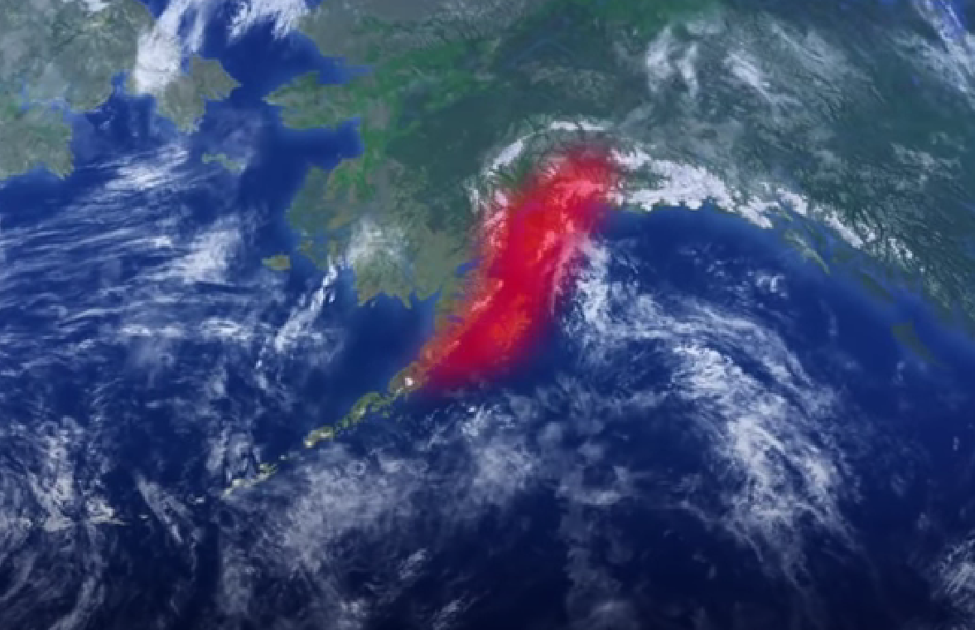

Slide 18
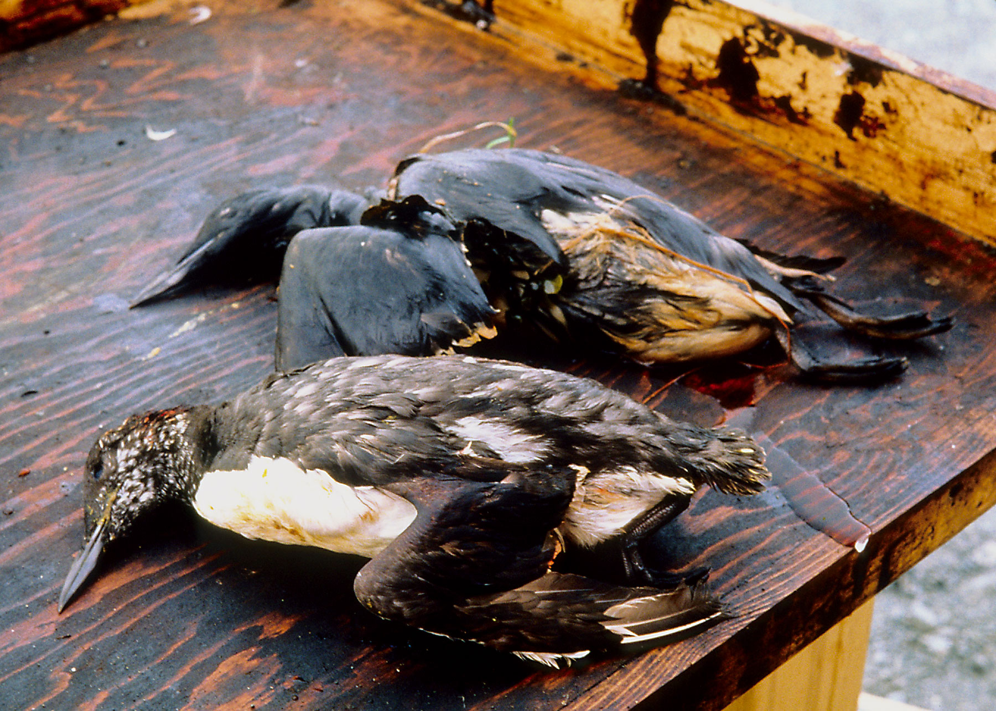
DAMAGE & LOSS
It is considered to be one of the most devastating human-caused environmental disasters ever to occur. 100,000 to 250,000 seabirds died, as well as at least 2,800 sea otters, approximately 12 river otters, 300 harbor seals, 247 bald eagles, and 22 orcas, and billions of salmon and herring eggs were destroyed.

Slide 19
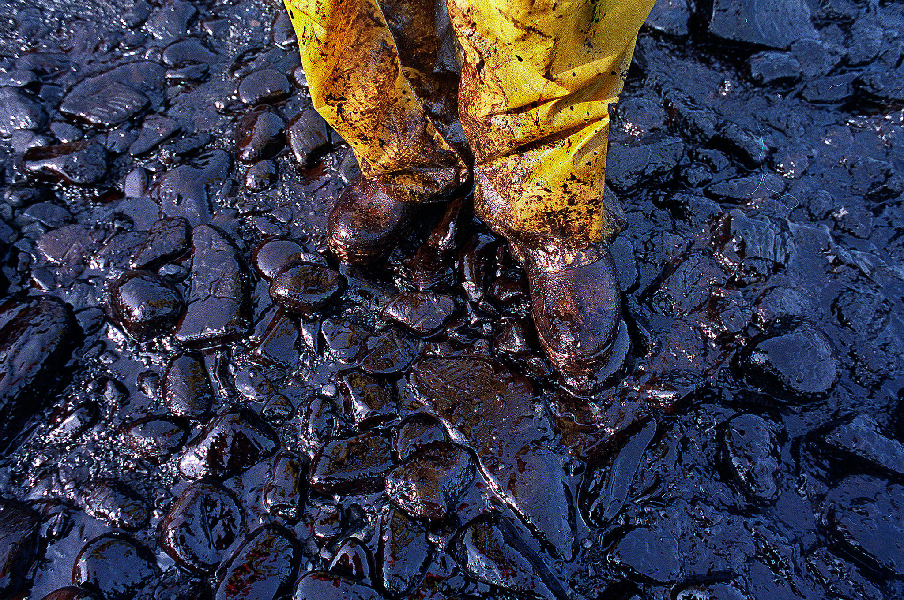
Overall reductions in population have been seen in various ocean animals, including stunted growth in pink salmon populations. Sea otters and ducks also showed higher death rates in following years, partially because they ingested prey from contaminated soil and also from ingestion of oil residues on their hair/feathers due to grooming.

Slide 20
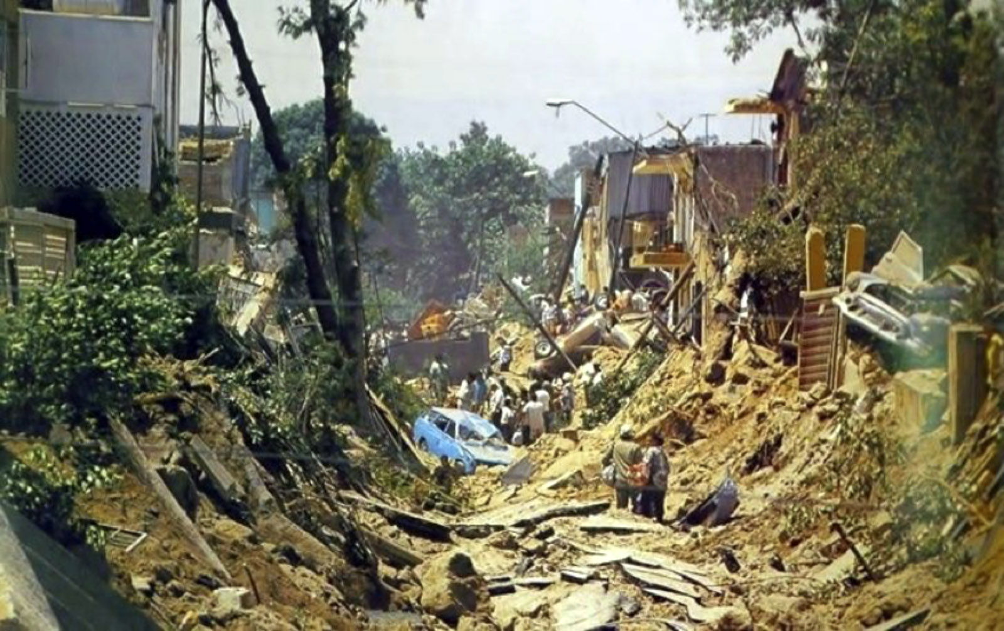
1992 Guadalajara Explosions
A series of ten explosions took place on April 22, 1992, in the downtown district of Analco Colonia Atlas in Guadalajara city, Jalisco state, Mexico. Numerous gasoline explosions in the sewer system and fires over four hours destroyed 8 kilometers (5.0 mi) of streets. Lloyd’s of London reported around 252 deaths.

Slide 21
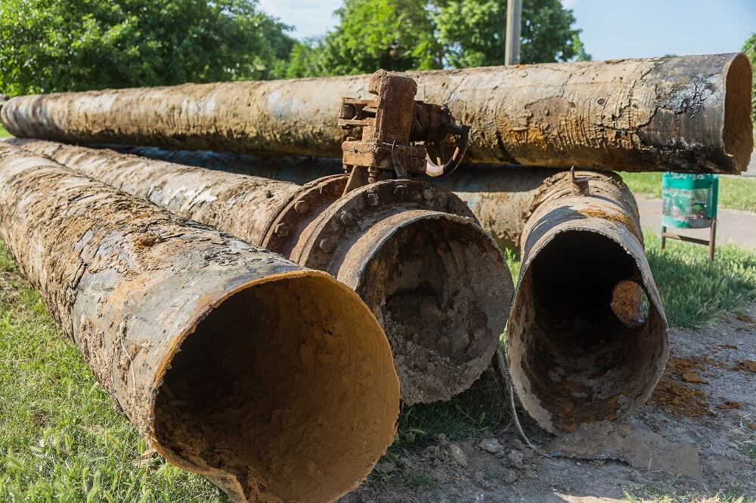
CAUSE
New water pipes, made of zinc-coated iron, were built too close to an existing steel gasoline pipeline. The underground humidity caused the steel pipe to corrode, creating a hole in the pipeline that permitted gasoline to leak into the ground and into the main sewer pipe.

Slide 22
CHRONOLOGY OF EXPLOSIONS
The Guadalajara explosions were a series of gas explosions that took place in Guadalajara, Mexico on April 22, 1992.
The explosions were caused by a buildup of gasoline and other hydrocarbons in the sewers, which were detected and investigated by the City Council and Civil Protection.
The first two explosions were recorded at 10:05 AM, followed by six more throughout the morning and afternoon.

Slide 23
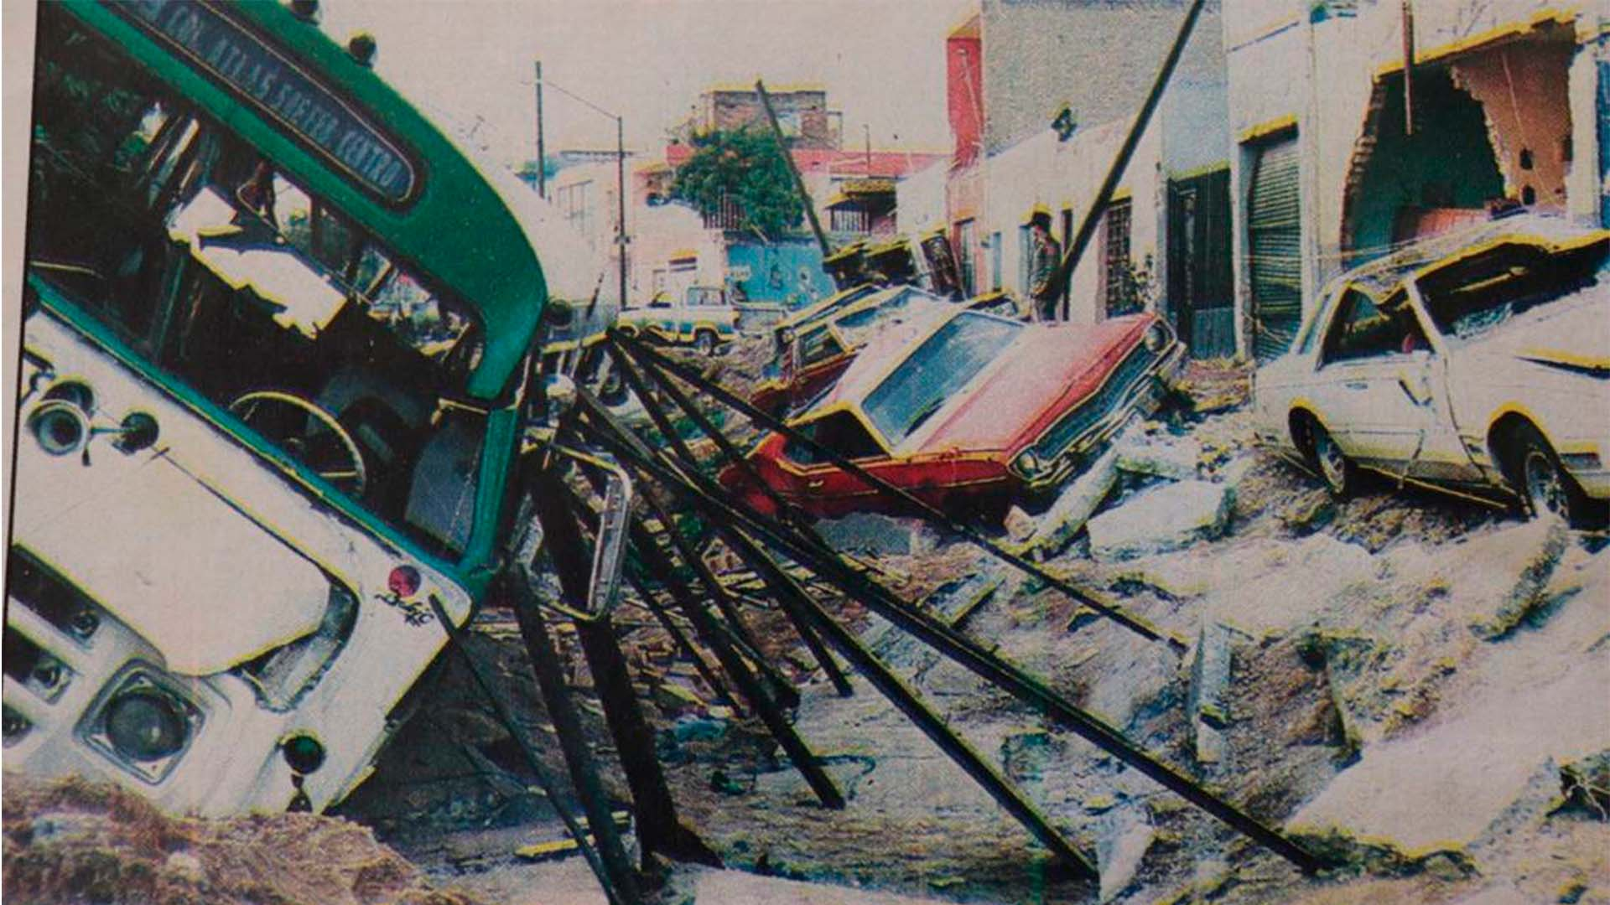
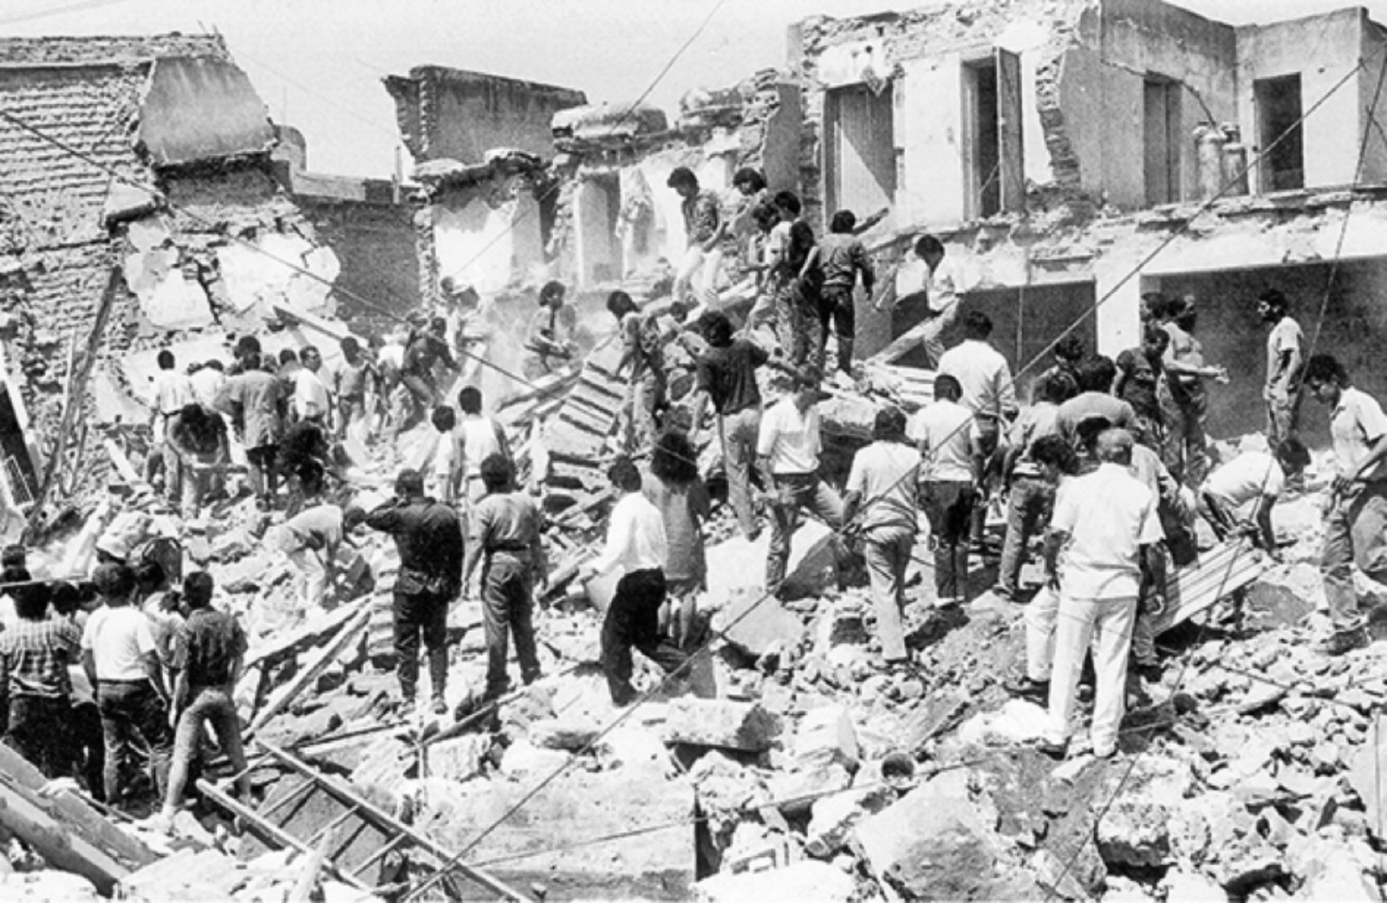
The explosions led to evacuations across multiple neighborhoods in the Guadalajara Metro Area, as well as a panic on April 25 due to a gas leak in a Pemex pipe. The Guadalajara explosions caused widespread damage and panic in the city.

Slide 24
LOSS
By the accounting of Lloyd's of London, the reported number of people killed was about 252, although many estimate that the catastrophe actually caused at least 1,000 deaths.
About 500 to 600 people were missing, nearly 500 were injured and 15,000 were left homeless.
The estimated monetary damage ranges between $300 million and $3 billion. The affected areas can be recognized by the more modern architecture in the areas that were destroyed.

Slide 25
THANK YOU

